Slide 1


Processing of Electroactive Components by means of Selective Laser Sintering / Melting (SLS/SLM)
M. Gonon, N. Basile
Fifteenth European Inter-Regional Conference on Ceramics
CIEC 15 5th-7th September 2016

Slide 2
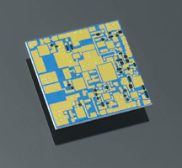
Context
Ceramic materials are the functional materials of a large number of electronic components.
Complexes devices are composed of superimposed layers (conductors, semi-conductors, dielectrics, …) directly bounded over an insulating substrate.
Processing such devices requires numerous deposition / firing steps :
Time and energy consumption
Firing conditions must be compatible with thermal stability of all already deposited materials.
Compromises in terms of compositions and final microstructure and properties
Substrate cleaning
Ink serigraphy
Drying
x n
Firing
Final component
conductors
Functional layer
Substrate

Slide 3
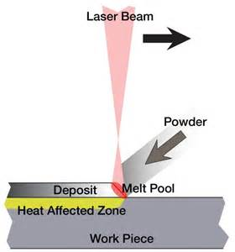
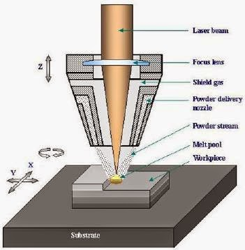
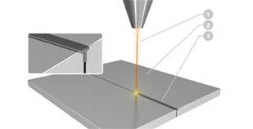
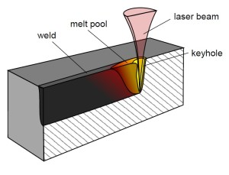
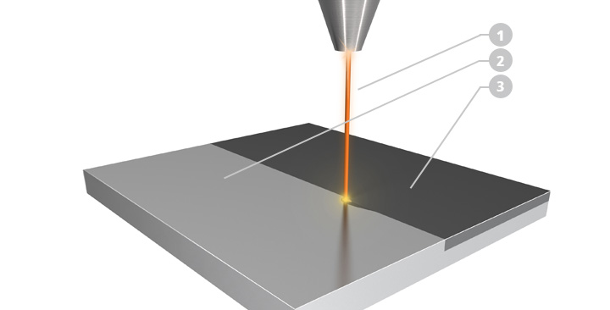
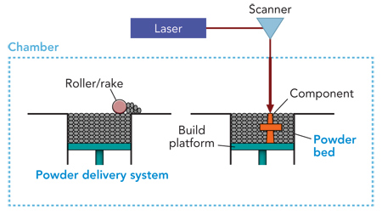
Context
Cladding alloying
Machining
Laser source
Welding / brazing
Surface treatment (quenching , vitrification ; crystallization)
Additive manufacturing

Slide 4




Context
Would it be possible to consolidate and densify the different layers of an electronic component by mean of a laser beam ?
Lasesurf projet
Conductive metallic tracks
Electroactive ceramics layers

Slide 5
Selective laser melting / sintering
Laser treatments
0 Dimension
dots
1 Dimension
lines
2 Dimensions
areas
static
dynamic
static

Slide 6
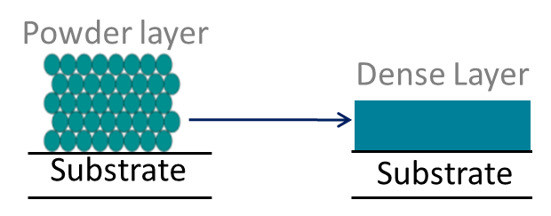
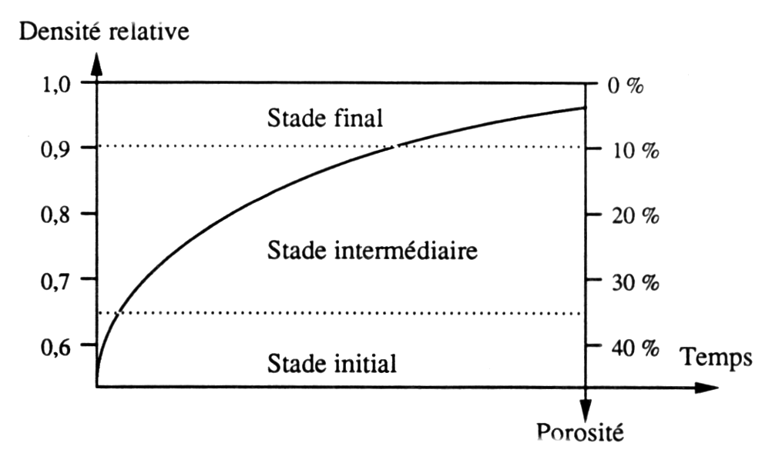
Selective laser melting / sintering
Grains bridging
Densification
Grain growth
Phases transformation
Sintering of a powder layer
Mechanisms
Parameters
Temperature
Time
Relative density
Porosity
Final stage
Specific surface (m²/g)
Relative density
Intermediate stage
Sintering
Initial stage
Time
Temperature (°C)
Shrinkage (Porosity resorption)
Temperature gradients
Thermal expansion
mismatch layer / substrate

Slide 7
Selective laser melting / sintering
Sintering of a powder layer
Temperature of the grains
    → true power density (absorbed)
    → grains size, shape, specific energy and thermal conductivity
    → interaction time
Interaction time
    → dynamic or stationary
    Dynamic mode = Short interaction time
    → non stationary regime + complex thermal history
    → thermal gradient between surface and center of the grains.
    → compatibility with diffusion kinetics ?
    → Fast local heating and cooling = thermal chocks

Slide 8
Selective laser melting / sintering
Processing parameters
Beam diameter
φ (µm)
Power P (W)
Speed s (mm/s)
Scan strategy
1 way or 2ways
Vectorization
v (µm)
Power density (W/mm²) : P_{w} = P / (πφ²/4)
Interaction time (s) : t* = t_{s} x (S_{beam} / S_{scan}) = π φ²/ (4 v s)
Energy density (J/mm²) : J* = P_{w} t* = P / (s v)
Overlapping (%) : Ov = 100 (φ – v) / φ

Slide 9
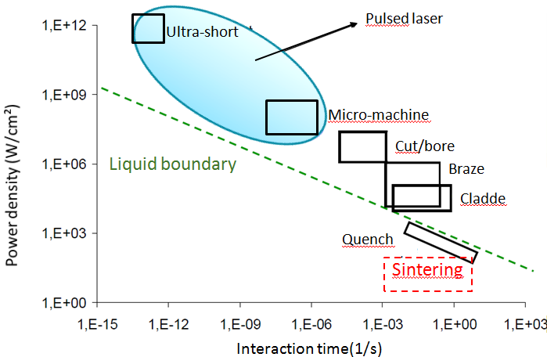
Selective laser melting / sintering
Processing parameters
Sintering ?
Interaction time (s)
Laser Cladding: Jan Gedopt, Marleen Rombouts Lasercentrum Vlaanderen

Slide 10
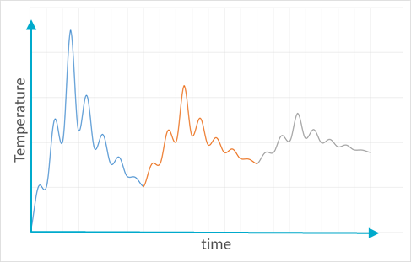
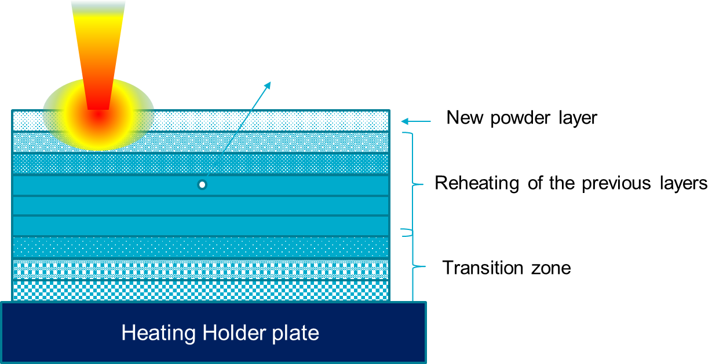
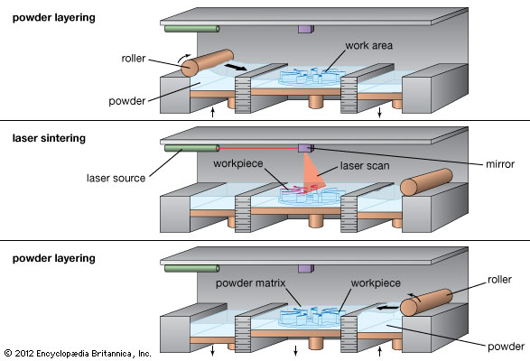
Selective laser melting / sintering
Processing parameters
Thermal history
Example of the use of a laser beam as energy source to built up layer by layer a complex 3D monolithic structure (additive manufacturing).

Slide 11

Lasesurf Projet
Challenge
Application to thick powder layers deposited on a substrate ?
Problems :
Very short time of treatment
Already dense substrate
Multi materials
Selected material : BaTiO₃
Objective : process a 10 to 100 µm tick layer on an alumina substrate

Slide 12
Lasesurf Projet
Procedure
1 : Treatment of BaTiO₃ powder pellets.
Parameters leading to a consolidation of the surface
Characterize the microstructure
Identify consolidation mechanisms
2 : Treatment of a BaTiO₃ powder layer
Powder deposited on an alumina substrate Ag coated or not.
Influence on the scanning conditions
BaTiO₃
BaTiO₃
Alumina
BaTiO₃
Ag
Alumina

Slide 13
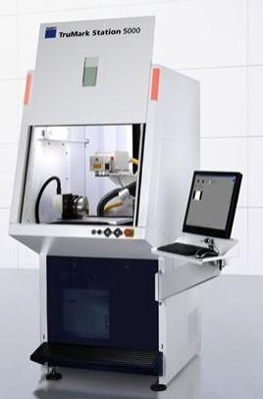
Treatment of BaTiO₃ powder pellets
Equipment / Characterization
Trumark Station 5000 (Trumpf)
Solid-state laser (Nd-YVO₄)
P_{max} = 22,8 W (cw)
λ = 1064 nm
φ = 45 µm
s = 0 to 7000 mm/s
Characterization :
Visual aspect
XRD
SEM

Slide 14
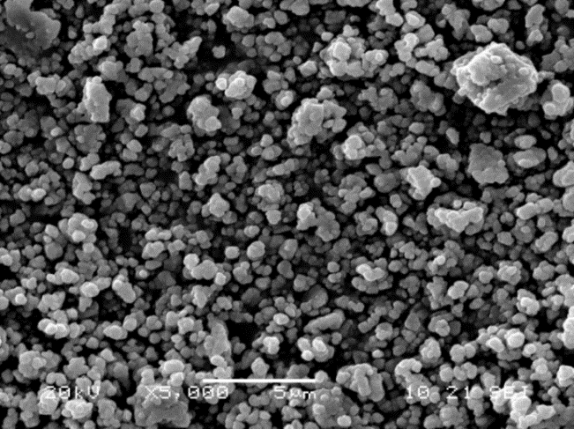
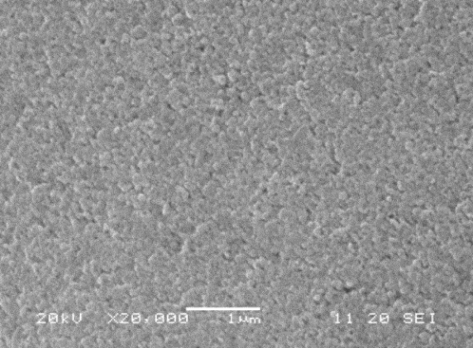
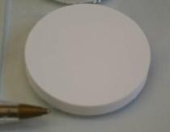
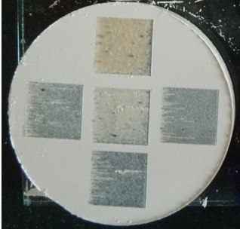
Treatment of BaTiO₃ powder pellets
BaTiO₃ pellets
Parametric investigation
Tetragonal BaTiO₃ Powders :
micro, d₅₀ = 0,44 µm (Sigma Aldrich)
nano, d₅₀ = 50 nm (Inframat Advanced Materials )
mixtures micro / nano
P_{w} = P / (πφ²/4)
t* = π φ²/ (4 v s)
J* = P_{w}.t*
Scanned area
10 x 10 mm²

Slide 15
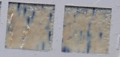
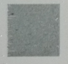
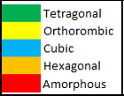
Treatment of BaTiO₃ powder pellets
Influence of scan parameters
Influence of s and v
P = 100 % (22,8 W)
P_{w} = 1,4 10⁶ W/cm²
P_{w} = P / (πφ²/4)
t* = π φ²/ (4 v s)
J* = P_{w}.t*
15 % nano
s = 80 mm/s
v = 10 µm
t* = 2 ms
J* = 2,85 kJ/cm²
s = 1000 mm/s
v = 10 µm
t* = 0,16 ms
J* = 0,228 kJ/cm²

Slide 16
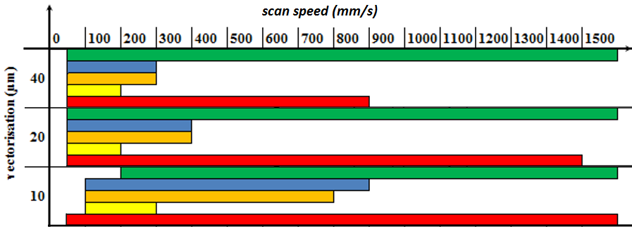
Treatment of BaTiO₃ powder pellets
Influence of s and v
t* = π φ²/ (4 v s)
same s.v = same t* and then same J*
High temperature forms of BaTiO₃ if t* > 0,13 ms
Amorphous phase if t* > 0,04 ms
But differences in t* limits according to v and s

Slide 17
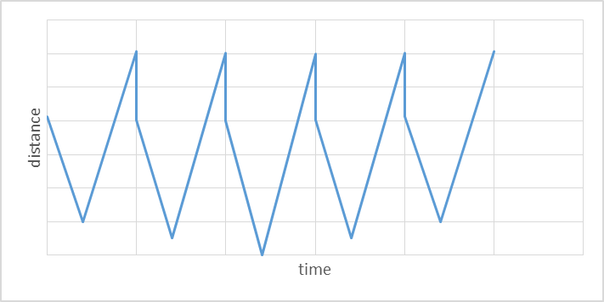
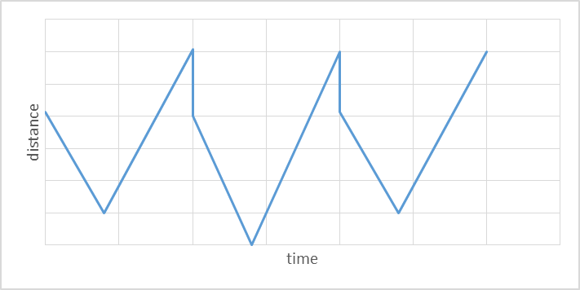
Treatment of BaTiO₃ powder pellets
Influence of s and v
For given P_{w} and t*, the thermal profile of a given point of the scanned surface will be depending on it distance to the laser beam vs time.
t* = π φ²/ (4 v s)
v₁, s₁
2v₁, s₁/2
If speed is lowered and vectorisation increased, the laps of time between two close positions increases what favor cooling before reheating.

Slide 18
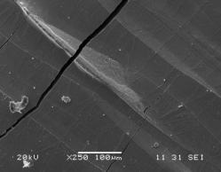
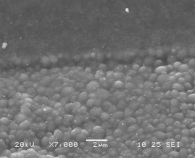
Treatment of BaTiO₃ powder pellets
Influence of s and v
High amount of glassy phase.
→ Melting of nano and significant part of micro grains.
High temperature crystal form of BaTiO₃.
→ high rise in temperature of the core of the larger grains.

Slide 19
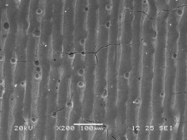
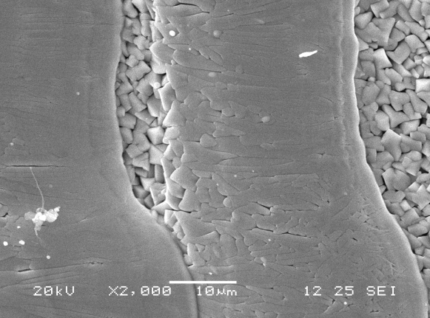
Treatment of BaTiO₃ powder pellets
Influence of s and v
Low amount of glass phase.
→ Melting of nano grains ?
Low temperature crystal form of BaTiO₃ and weak grain growth of the unmelted grains.
→ limited elevation of temperature of the core of the larger grains.

Slide 20
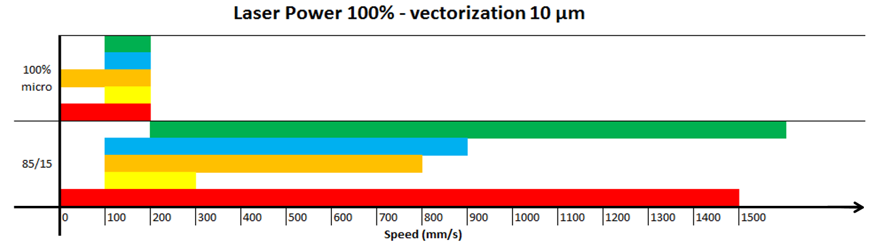
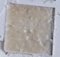
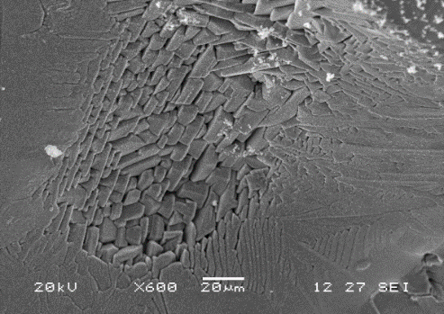
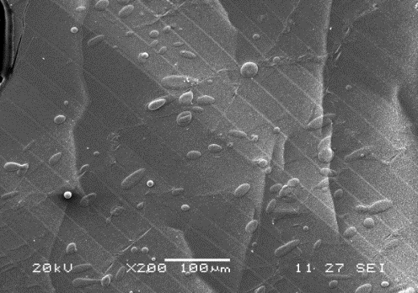
Treatment of BaTiO₃ powder pellets
Influence of s and v
Comparison mix micro + nano / pure micro
weak cohesion of sanned surfaces for s > 200 mm/s
s < 200 mm/s → glassy surface.
→ melting of a large part of the grains.
→ phase transformation and growth of unmelted grains.

Slide 21
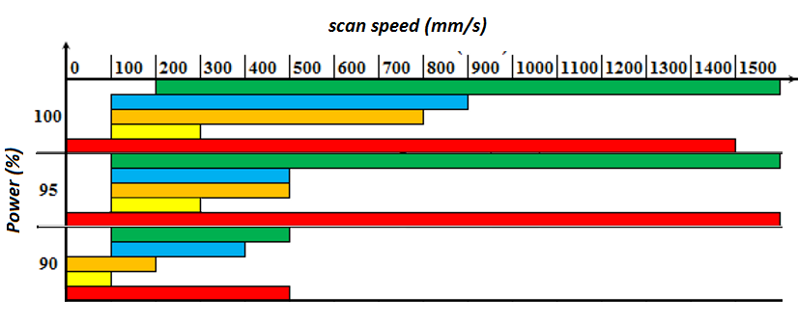
Treatment of BaTiO₃ powder pellets
Influence of P and s
v = 10 µm
P_{w} = P / (πφ²/4)
t* = π φ²/ (4 v s)
J* = P_{w}.t*
Higher t* limits if P_{w} decreases from 100 % down 95% and 90%.
However, no cohesion of scanned surface if P < 90 % (P_{w} = 1,3 10⁶ W/cm²).
→ the increase in t* thorough a decrease in s doesn't compensate the decreased in P_{w} (a cte J* is not sufficient to lead to a same result).

Slide 22
Treatment of BaTiO₃ powder pellets
Conclusion influence of scan parameters
Possible to obtain consolidated t-BaTiO₃ layers.
Need of a fraction of fine grains that melt for “low” energetic conditions.
Interaction time t* must be short enough to limit the melted fraction and avoid phase transformation of the larger grains.
  t* limit depend on vectorisation v and speed s.
Energy density J* is not a pertinent parameter : P_{w} cannot be lowered below 1,3 10⁶ W/cm².

Slide 23
Consolidation of a BaTiO₃ powder layer
Procedure
1 : Treatment of BaTiO₃ powder pellets.
Parameters leading to a consolidation of the surface.
Characterize the microstructure.
Identify consolidation mechanisms.
2 : Treatment of a BaTiO₃ powder layer
Powder deposited on an alumina substrate Ag coated or not.
Influence on the scanning conditions.
BaTiO₃
BaTiO₃
Alumina
BaTiO₃
Ag
Alumina

Slide 24
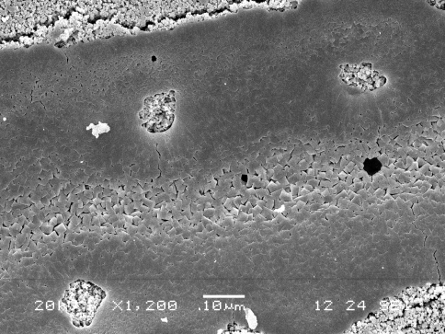
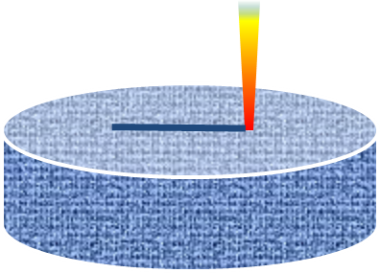
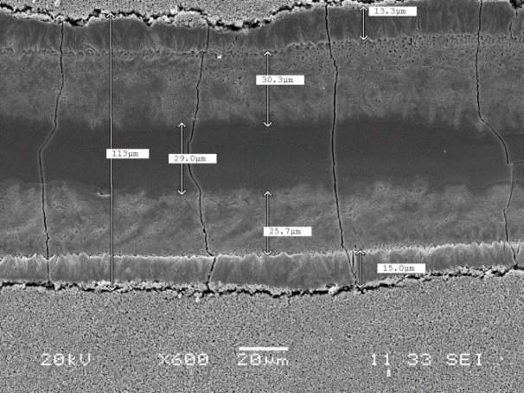
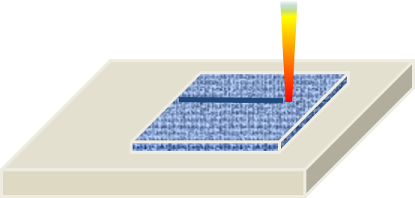
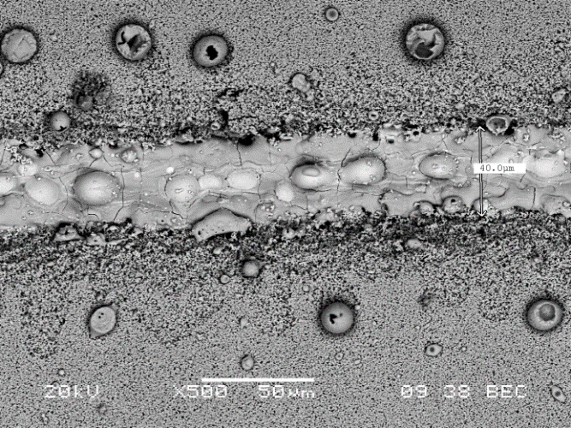
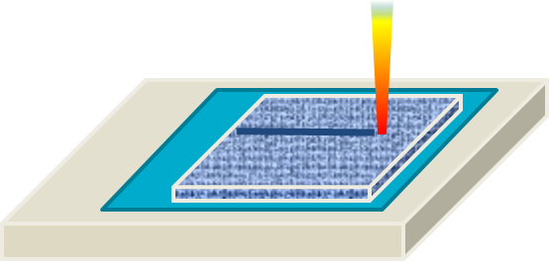
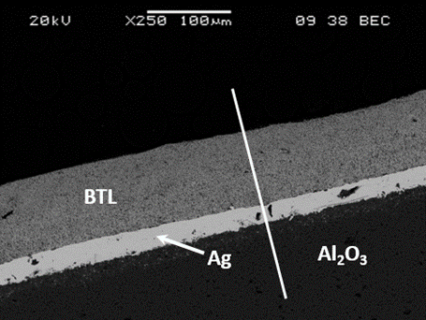
Treatment of BaTiO₃ powder layers
Interaction during a line scan
25 µm BaTiO₃ layers
80 µm
P = 100 % ; s = 1.000 mm/s

Slide 25
Treatment of BaTiO₃ powder layers
Interaction during a line scan
P = 100 % ; s = 1.000 mm/s
80 µm
20 µm
Pellets
80 µm
Substrate

Slide 26
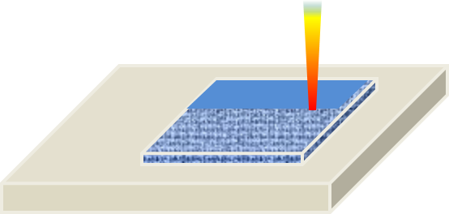
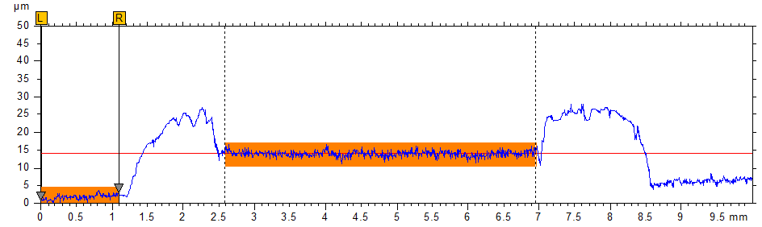
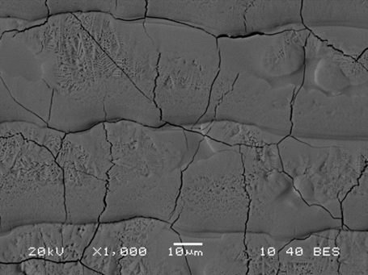
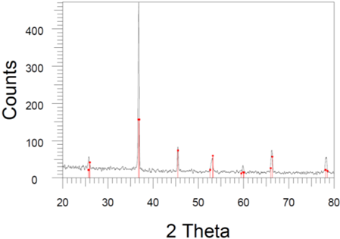
Treatment of BaTiO₃ powder layers
Surface scan
BaTiO₃ layer on alumina substrate
P = 100 % ; s = 1.000 mm/s ; v = 40 µm
P = 100 % ; s = 2.000 mm/s ; v = 20 µm
P = 100 % ; s = 4.000 mm/s ; v = 10 µm
t* = π φ²/ (4 v s)
40 µs

Slide 27
Treatment of BaTiO₃ powder layers
Conclusion powder layers
Problem of interaction with the substrate.
High temperatures reach by the powder layer not compatible with low temperature melting conductors as Ag.
Thermal gradients between the layer and the substrate cause dilatation / shrinkage mismatches generating stresses and cracks.
Target :
more homogeneous heating.
Avoiding melting (real solid state sintering).
Thermal characterization of the scanned surface during the laser treatment

Slide 28
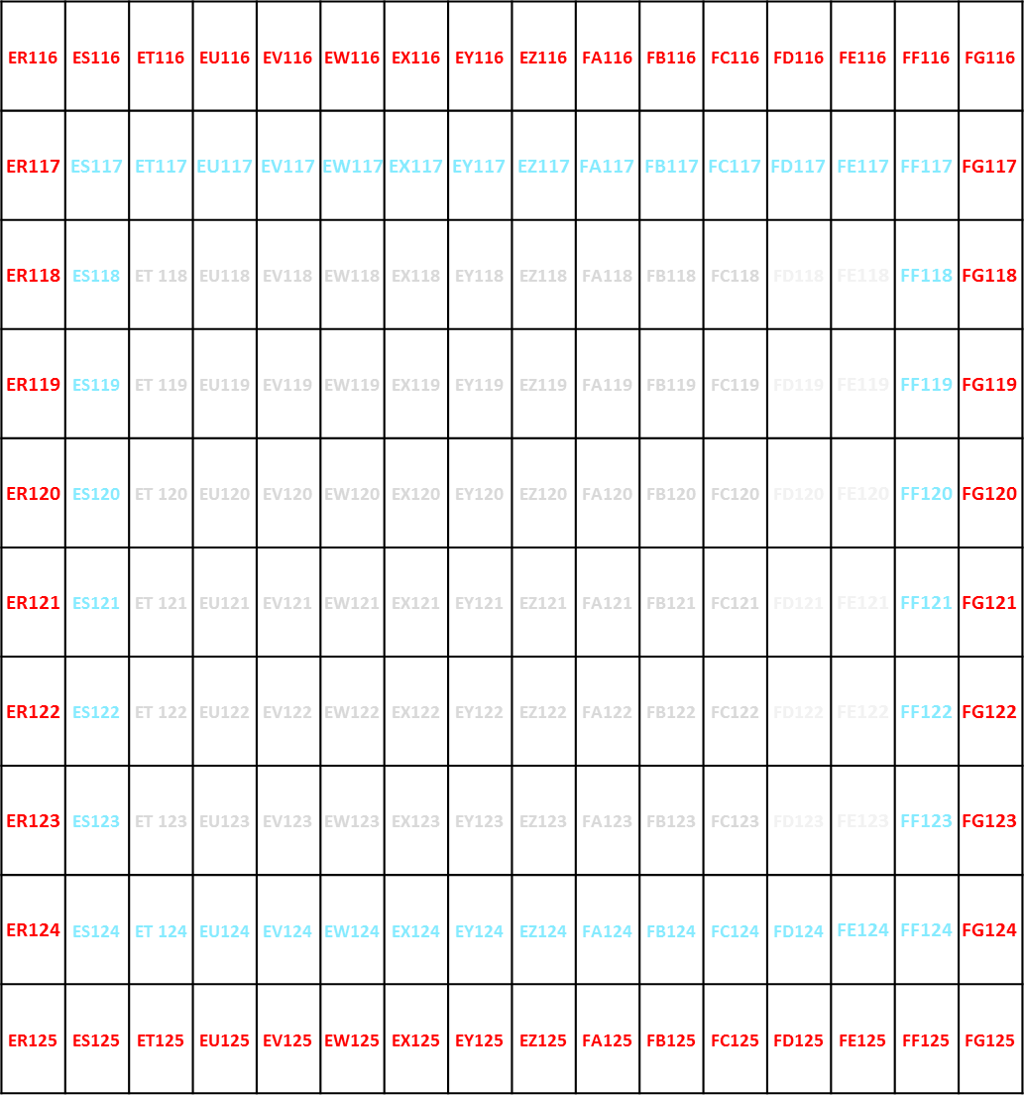
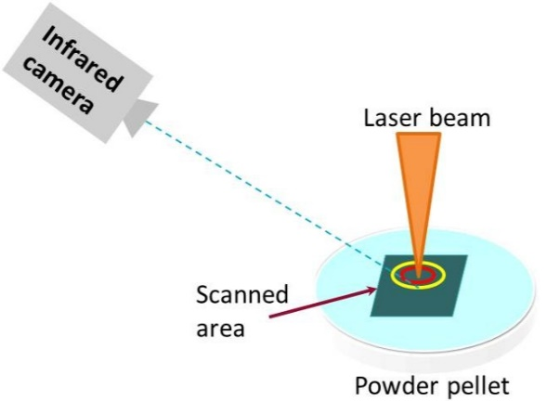
Thermal characterization of a laser scan
Infrared camera : FLIR AGEMA 750 PAL objectif FOV 24,
acquisition time : 2 s
Scanned Surface : 10 x 10 mm²
Spatial resolution : 12 x 8 mm²
Number of cells : 96 (8 x 12)

Slide 29
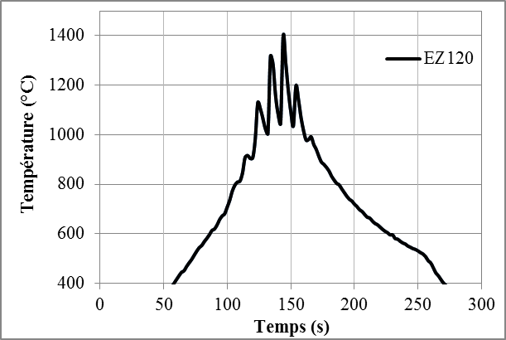
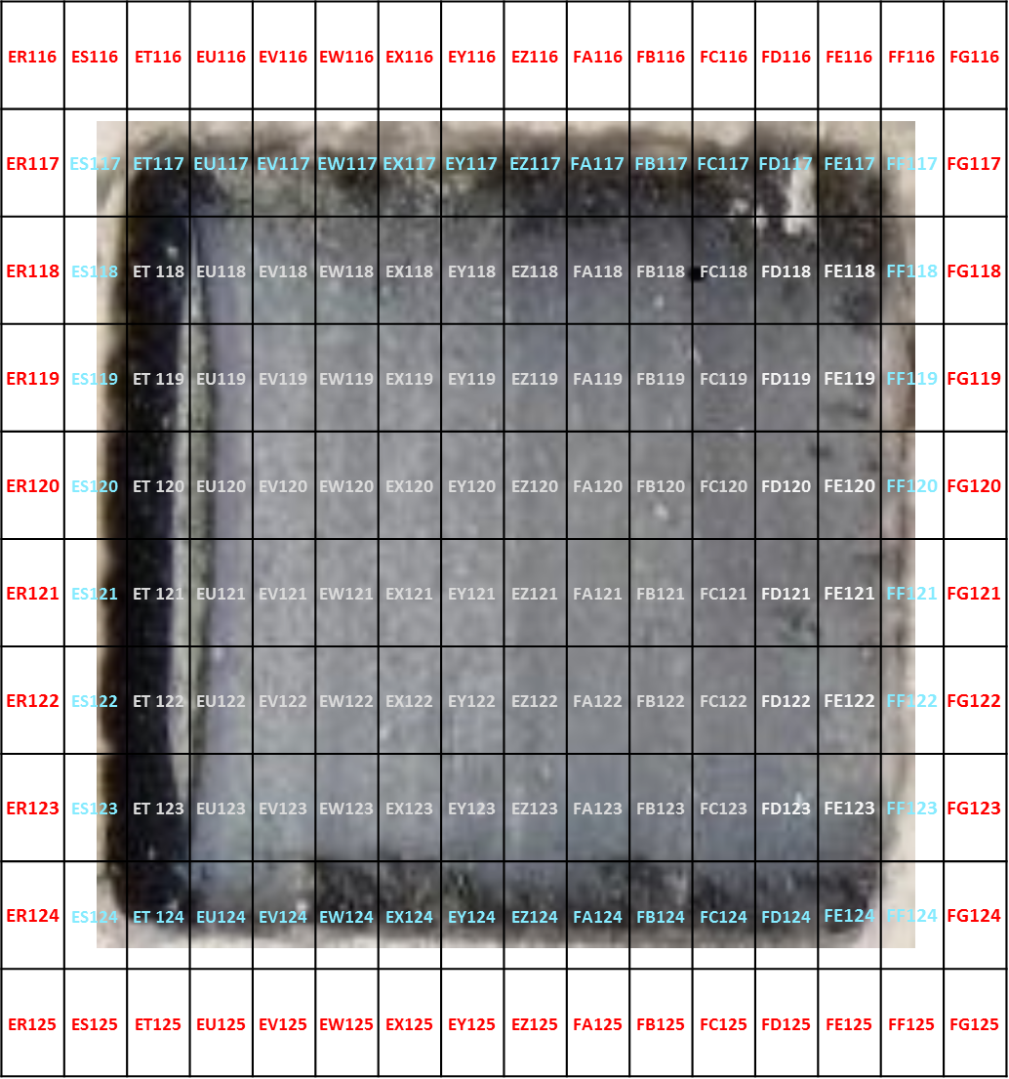
Thermal characterization of a laser scan
Power density : 1,4 10⁶ W/cm²
Vectorisation : 40 µm
Scan speed : s = 10 mm/s
Interaction time : t* = 3,5 10⁻³ s
≈20s
Vectorisation

Slide 30
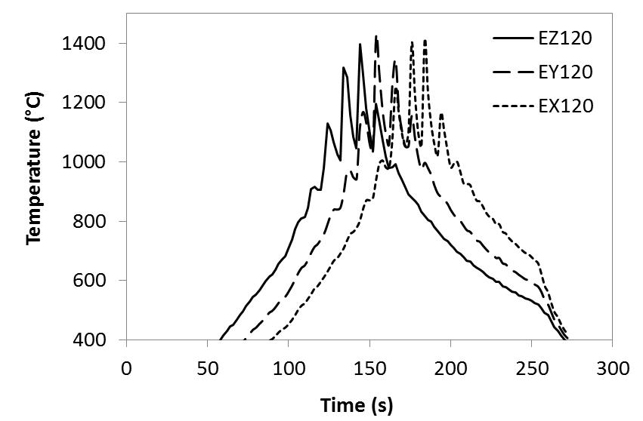
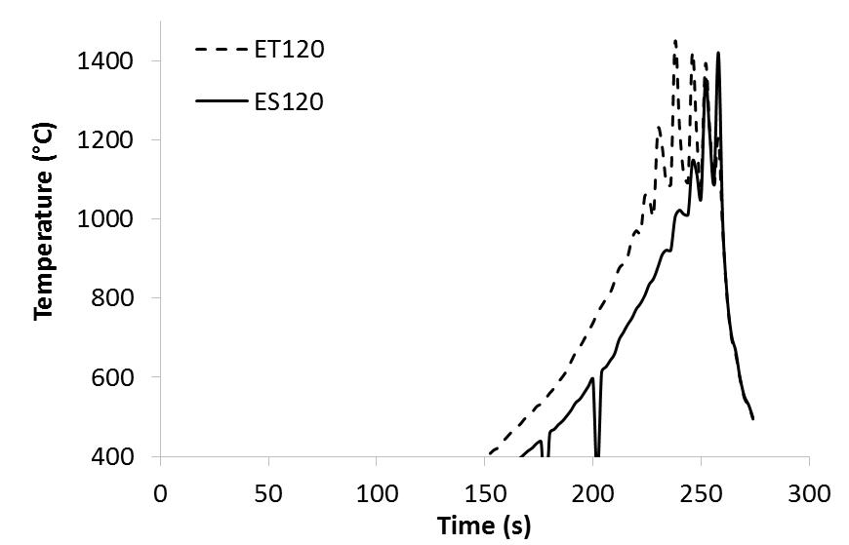
Thermal characterization of a laser scan
Power density : 1,4 10⁶ W/cm²
Vectorisation : 40 µm
Scan speed : s = 10 mm/s
Interaction time : t* = 3,5 10⁻³ s
Vectorisation

Slide 31

Thermal characterization of a laser scan
Scan speed : s = 30 ; 10 ; 5 mm/s
t* = π φ²/ (4 v s)
Vectorisation

Slide 32


Thermal characterization of a laser scan
Vectorisation
Scan speed : s = 10 mm/s
t* = π φ²/ (4 v s)
10 x 10 mm²
20 x 10 mm²
10 x 20 mm²

Slide 33


Thermal characterization of a laser scan
At high speed, time resolution of IR camera (2 s) doesn't allow to follow temperature of a selected zone during 1 cycle.
Repeated cycles :
Min ; Average and Max temperature of the scanned surface vs time.
Influence of speed.
1000 mm/s
5000 mm/s

Slide 34
Thermal characterization of a laser scan
Weak heating of the cells during the first cycles.
Heating is limited to a little area around the laser beam.
1000 mm/s
High temperature gradient over the scanned surface a low speed.
Limited gradient at high speed.
5000 mm/s

Slide 35

Thermal characterization of a laser scan
A temperature plateau is reached after 80 s.
The maximum temperature is not influenced by the speed.
The heating rate at sort time is higher for high speeds.

Slide 36
Thermal characterization of a laser scan
Conclusion thermal characterization
Interaction time t* is not a characteristic parameter.
short vectorisation v and high speed s = more progressive and homogeneous heating.
Possibility of increasing interaction time by mean of a multiscan strategy.
= very short interaction time during one cycle (very high speed) but repeated several times.
= control of the heating profile of the scanned surface.
t* = π φ²/ (4 v s)

Slide 37




Thermal characterization of a laser scan
Conclusion thermal characterization
100 µm BaTiO₃ Layer
P = 100 % ; v = 40 µm
s = 2500 mm/s ;
s = 5.000 mm/s ;
X 60 s
Consolidation but no densification

Slide 38
Thermal characterization of a laser scan
Conclusion / outlooks
Possibility to consolidate and densify a BaTiO₃ layer through the melting of a low volume fraction of small powder grain.
But not compatible with other materials.
Mismatch with the substrate leading to cracks.
A real solid state sintering requires an increase of the total time of treatment while keeping a homogenous controlled heating of the surface :
= Mutiscan strategy
The maximum temperature reached in the stationary regime do not depend on the scanning speed but on the power density of the laser beam.
Limit of the equipment

Slide 39
  Thank you for your attention

